Slide 1
Next Steps Proposal
Xinran Chen, Tianyu Han, Ying Hong,
Siyu Shen, Shiyuan Xu
From Columbia MS Data Science

Slide 2
Agenda
PCA Result and Analysis
Proposal for Augmented Data and image classification

Slide 3
PCA Analysis
[0.1270646 0.07867379 0.05543095 0.05293028 0.0428575 0.03656207 0.03529208 0.03283393 0.03128436 0.03041952]
The PCA results aid in dimensionality reduction. By focusing on the principal components that explain the most variance, we can simplify our models and potentially uncover hidden patterns more effectively.
The first ten principal components were extracted. The variance explained by these components decreases sequentially, with the first component explaining 12.71%, followed by 7.87%, 5.54%
After applying the dataset after dimensionality reduction to the model, the auc actually dropped, so the result would not be used.

Slide 4
Data Overview
Limitation of text data
Instead of using 4 years of data, we will only focus on the data of 03-06 as they have more common features, allowing for easier data replication.
Explore image data of psoriasis (due to potential unavailability in large quantities, may need image augmentation)

Slide 5
Data Augmentation
Due to the low number of positive labels in the dataset, we propose to manually generate “fake samples” by mimicking the distribution of true positive labels.
For selected features, we will explore the distribution of each feature
Then use the combined distribution of those selected features to randomly generate, in theory, unlimited samples
Each column of these samples will follow the true distribution of the features extracted from the dataset
The intuition is that the psoriasis patients have some features that underlies a distribution different from the rest of the questionnaire participants, we aim to magnify the difference, thus making difference more obvious for the classifying algorithms

Slide 6
Oversampling Vs. Aug. Data
O.S.
Fast, no additional exploration of the dataset is required
High repetition of same samples could lead to overfitting
Well developed
A.D.
Requires extensive amount of pre-processing
mitigates the limitations caused by having identical samples
Requires empirical validation

Slide 7
Example of Generating one Sample of A.D.
Assume that we select three features: Vitamin D, age, and # of cigarettes smoked per day.
Extract only the positive labels from NHANES (in this case, people diagnosed with psoriasis)
Learn the distribution of the three features from the selected dataset
Randomly generate one value following the learned distribution for each categories mentioned above.
Concatenate the values and label it as positive
Repeat until have desired number of positive samples.

Slide 8
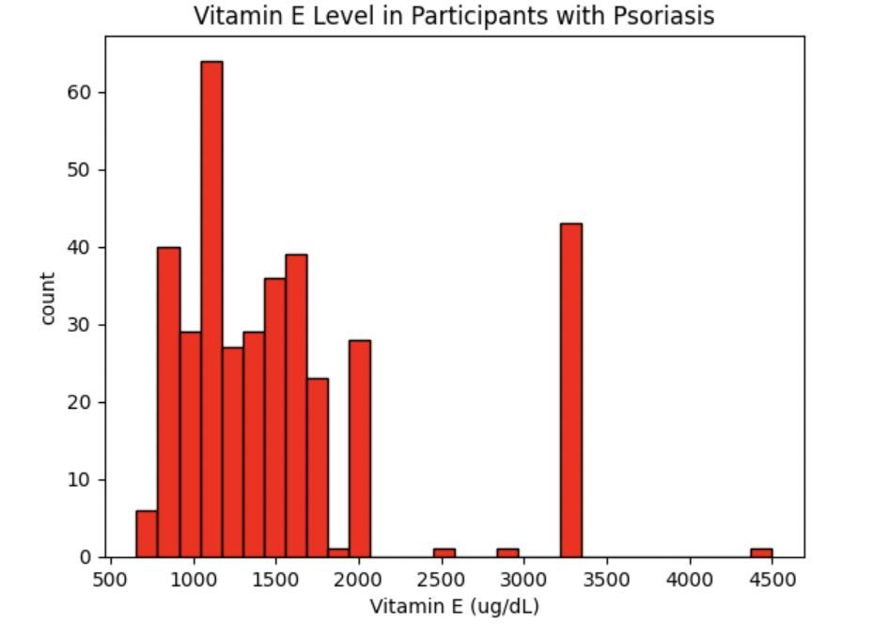
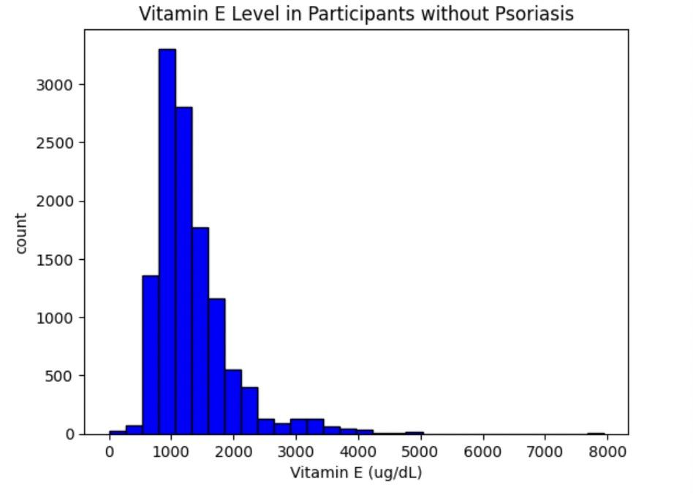
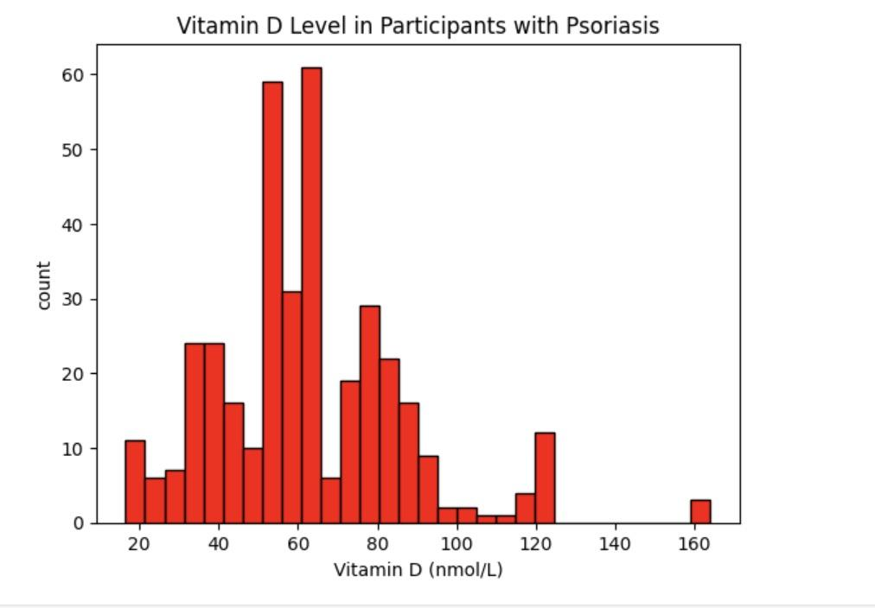
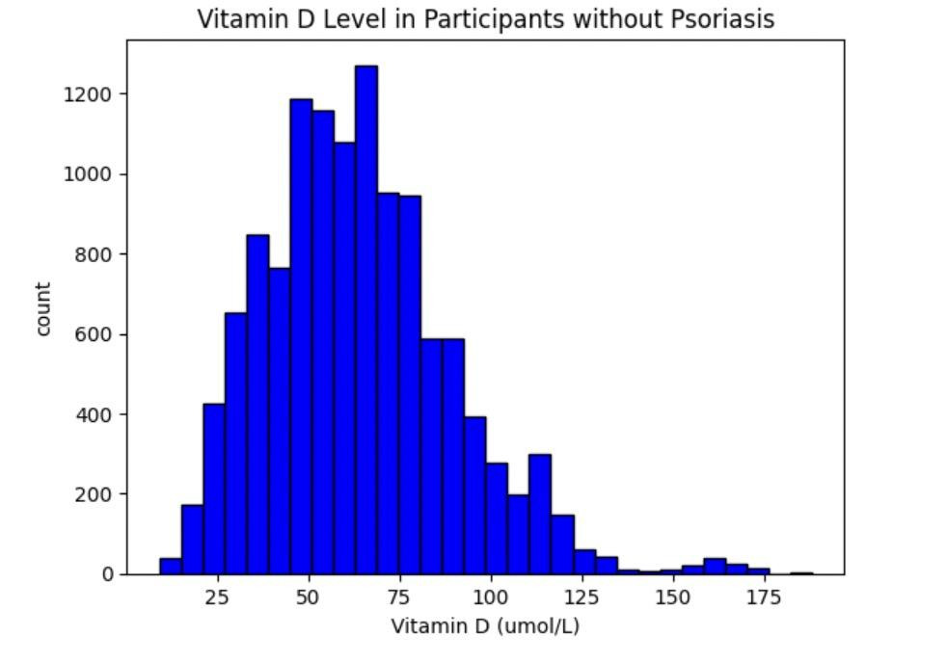
Graph Illustration
We see that there is a observable difference between the two groups. We hope that the manually generated data will magnify this difference.

Slide 9
Image Classifier
Objective: Develop a robust computer vision deep learning model capable of accurately classifying psoriasis in images.
Input:
The model will take high-resolution images of skin lesions potentially indicative of psoriasis, downloaded from the internet. The dataset will be carefully curated to encompass a broad range of psoriasis cases, with a specific focus on including images of healthy skin to facilitate a comprehensive training process.

Slide 10
Image Classifier
Expected outcome:
High Accuracy: Achieve a high accuracy rate in classifying psoriasis lesions and healthy skin from medical images.
Generalization: Ensure the model's ability to generalize well to new and unseen cases, contributing to its applicability in real-world scenarios.

Slide 11
Image Classifier
Challenges:
Data Quality: Ensure that downloaded images are of sufficient quality and consistency, addressing potential variations in lighting conditions and resolution.
Labeling Accuracy: Overcome challenges associated with accurate labeling, especially for psoriasis cases that may not always exhibit clear visual indicators.
Dataset Bias: Be aware of potential biases introduced by internet-collected data and take steps to mitigate them during model training.

Slide 12
Next Step
Further exploration into finding image datasets for psoriasis condition
Implementation of two methodologies

